Slide 1


Alejandro Castellanos
May 5th

Slide 2

Executive Summary
In the fast-evolving landscape of commercial space exploration, Space Y embarked on a mission to revolutionize rocket launch operations through predictive analytics. Leveraging a comprehensive dataset obtained from SpaceX API and web scraping, coupled with meticulous preprocessing techniques including data wrangling, exploratory data analysis (EDA), and data visualization, this project aimed to forecast the outcomes of rocket launches with precision. By harnessing machine learning algorithms such as Logistic Regression, Support Vector Machines (SVM), Classification Trees, and K-Nearest Neighbors (KNN), we endeavored to optimize decision-making processes and enhance the efficiency of launch operations. Through rigorous model evaluation and hyperparameter tuning, we identified the Classification Tree model as the top performer, achieving an accuracy of approximately 87.3%. These results underscore the significance of preprocessing methodologies in extracting actionable insights from complex datasets, enabling Space Y to navigate the complexities of the commercial space industry with confidence and precision.

Slide 3
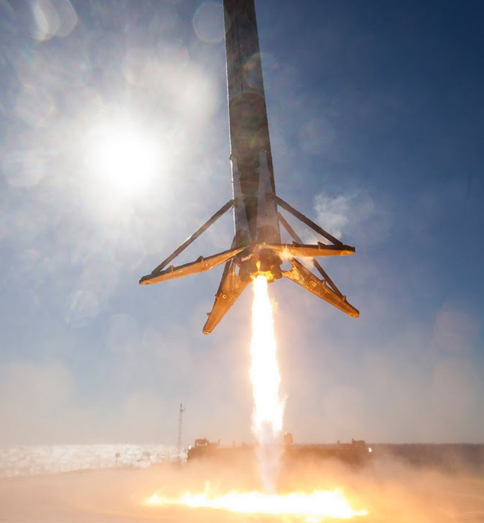
Introduction
In an era marked by the relentless expansion of space exploration boundaries, the commercial space industry emerges as a beacon of innovation and accessibility. Pioneered by companies such as Virgin Galactic, Rocket Lab, Blue Origin, and notably SpaceX, space travel has become democratized, offering unparalleled avenues for scientific progress and commercial ventures alike. SpaceX, with its groundbreaking achievements in satellite deployment, manned missions, and pioneering reusable rocket technology, has established itself as a formidable force within the industry. Yet, amidst this period of rapid advancement, new entrants like Space Y, spearheaded by visionary industrialist Allon Musk, aim to disrupt the status quo and claim their share of the market. As data scientists embarking on Space Y's capstone project, our objective is clear: to utilize data-driven insights and predictive analytics to decipher the intricacies of space launch operations, with a particular focus on the critical facet of first stage landings. Through the integration of machine learning and robust data analysis, our aim is to furnish Space Y with the requisite tools and knowledge to effectively navigate the complexities of the commercial space sector and vie with established giants like SpaceX.

Slide 4

Section 1

Slide 5
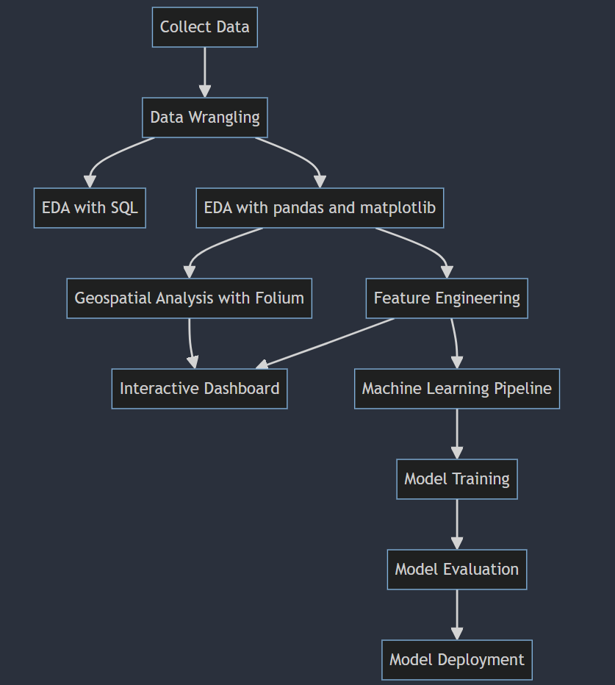
Methodology

Slide 6
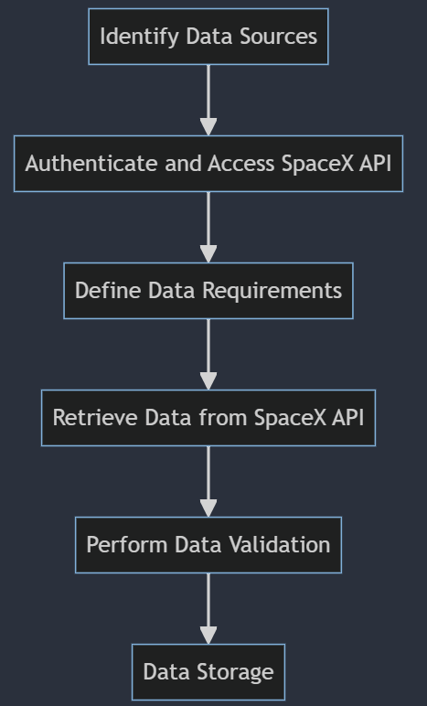
Data Collection – SpaceX API
Identify Data Sources: Begin by identifying relevant data sources, including the SpaceX API.
Authenticate and Access SpaceX API: Utilize authentication methods provided by the SpaceX API to gain access to the required data endpoints.
Define Data Requirements: Determine the specific data fields needed for the analysis, such as launch dates, mission details, rocket information, and landing outcomes.
Retrieve Data from SpaceX API: Implement requests to the SpaceX API to fetch the desired data, ensuring proper handling of pagination and rate limits.
Perform Data Validation: Validate the retrieved data to ensure accuracy, completeness, and consistency. This may involve checking for missing values, data formatting issues, and anomalies.

Slide 7
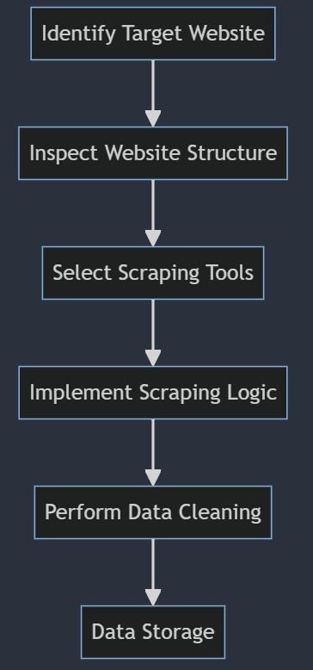
Data Collection - Scraping
Identify Target Website: Begin by identifying the target website containing the desired data. In this case, the Wikipedia page listing Falcon 9 and Falcon Heavy launches.
Inspect Website Structure: Analyze the structure of the target webpage to identify the location of the data elements to be scraped. This involves inspecting HTML tags, classes, and IDs.
Select Scraping Tools: Choose appropriate web scraping tools or libraries for the task. Popular options include BeautifulSoup in Python for HTML parsing.
Implement Scraping Logic: Develop scraping logic to extract the relevant data from the target webpage. This may involve navigating through HTML elements, selecting specific tables or sections, and extracting text or attributes.

Slide 8
Data Wrangling
Identify and Handle Missing Values:
Calculate the percentage of missing values in each attribute to assess data completeness.
Implement strategies to handle missing values, such as imputation, deletion, or flagging.
Identify Numerical and Categorical Columns:
Distinguish between numerical and categorical columns to facilitate data analysis and transformation.
Calculate Number of Launches on Each Site:
Aggregate data to calculate the total number of launches on each launch site, providing insights into launch distribution.
Calculate Number and Occurrence of Each Orbit:
Analyze the data to determine the unique orbits and their respective frequencies, aiding in orbit-related analysis.
Calculate Number and Occurrence of Mission Outcomes for Orbits:
Determine the number and occurrence of mission outcomes associated with each orbit, providing insights into mission success rates.
Create Landing Outcome Label:
Utilize information from the 'Outcome' column to create a new categorical variable indicating the landing outcome, facilitating predictive modeling.

Slide 9

Section 2

Slide 10
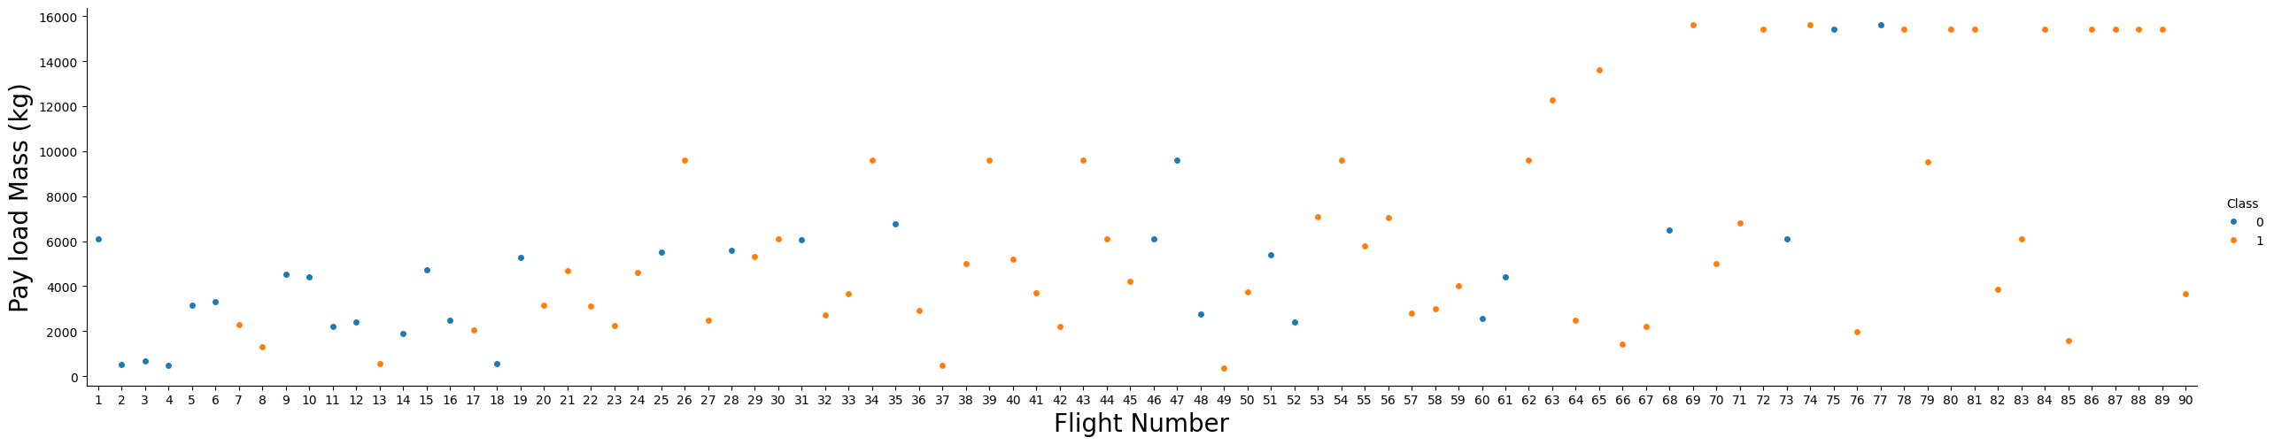
Flight Number vs. Payload Mass

Slide 11
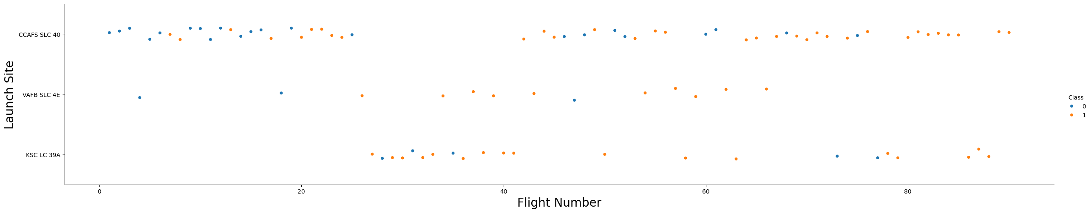
Flight Number vs. Launch Site

Slide 12
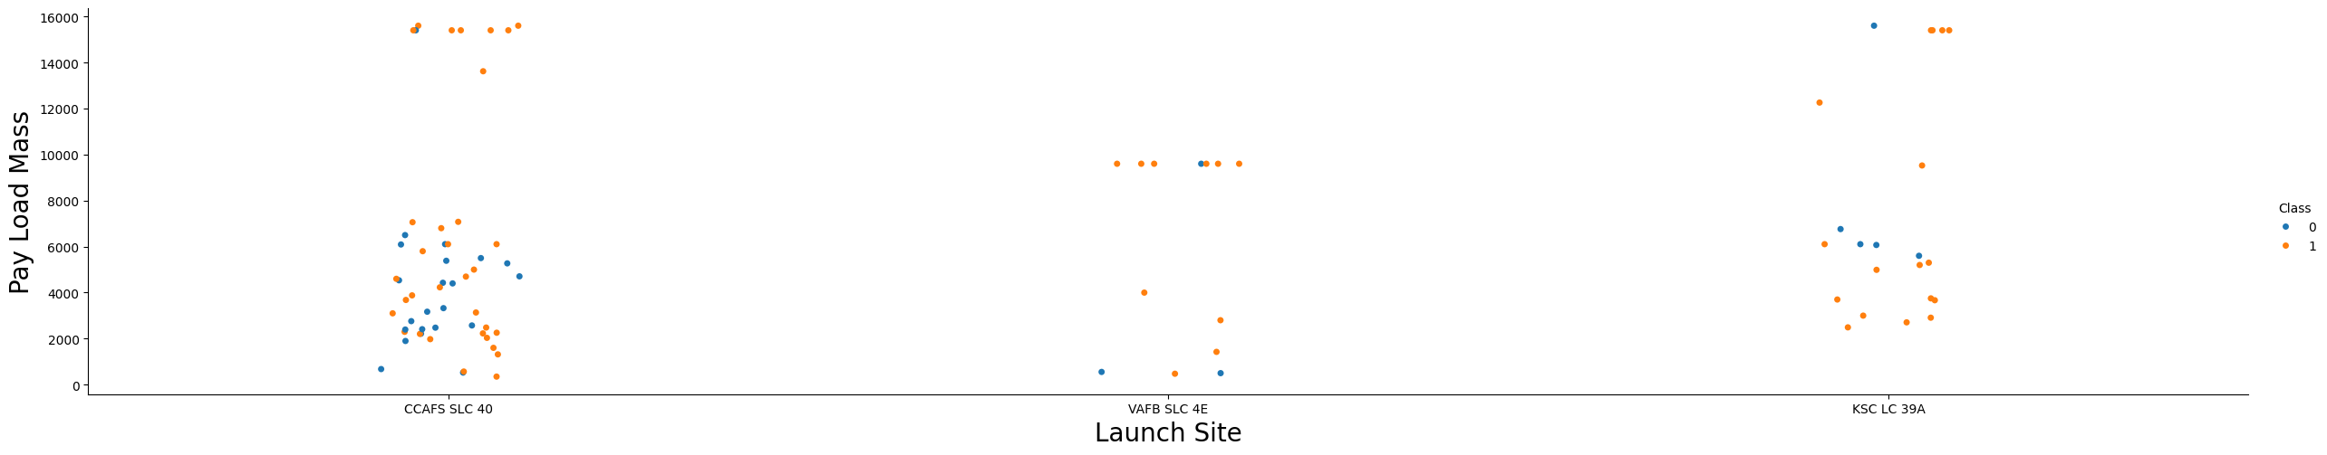
Launch Site vs. Payload Mass

Slide 13
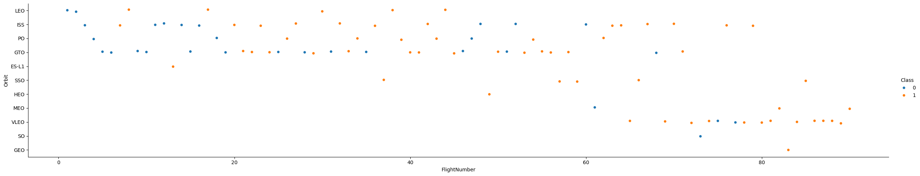
Flight Number vs. Orbit

Slide 14
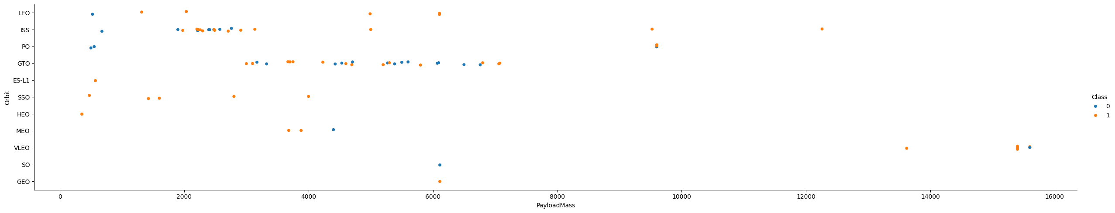
Payload Mass vs. Orbit

Slide 15
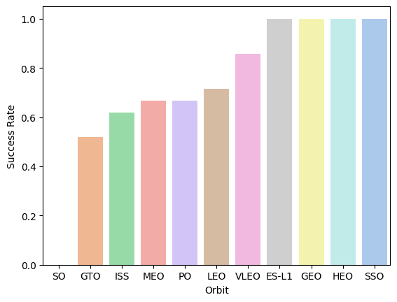
Success Rate for each Orbit

Slide 16
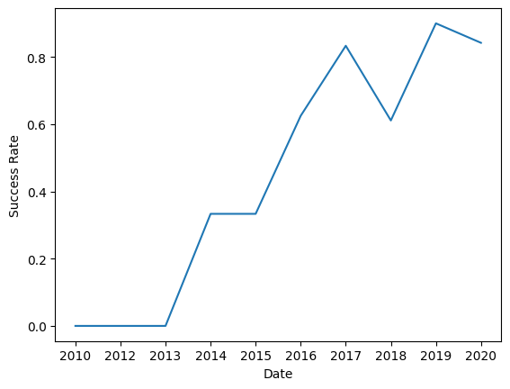
Success Rate Trend

Slide 17
EDA with SQL
A. Display the names of the unique launch sites in the space mission
B. Display 5 records where launch sites begin with the string 'CCA'
C. Display the total payload mass carried by boosters launched by NASA (CRS)
D. Display average payload mass carried by booster version F9 v1.1
E. List the date when the first successful landing outcome in ground pad was achieved.
F. List the names of the boosters which have success in drone ship and have payload mass greater than 4000 but less than 6000
G: List the total number of successful and failure mission outcomes
H. List the names of the booster_versions which have carried the maximum payload mass.
I. List the records which will display the month names, failure landing outcomes in drone ship, booster versions, launch_site for the months in year 2015
J. Rank the count of landing outcomes (such as Failure (drone ship) or Success (ground pad)) between the date 2010-06-04 and 2017-03-20.

Slide 18
Build an Interactive Map with Folium
Task 1:
Markers: Created markers to represent each launch site on the map, providing a visual indication of their locations.
Task 2:
Markers: Added markers to denote the success or failure of launches for each site on the map, distinguishing between successful and failed launches.
Task 3:
Circles: Utilized circles to visualize the proximity around each launch site, helping to calculate distances between the launch site and its surroundings.

Slide 19
Build a Dashboard with Plotly Dash
Summarize what plots/graphs and interactions you have added to a dashboard
Explain why you added those plots and interactions
Add the GitHub URL of your completed Plotly Dash lab, as an external reference and peer-review purpose

Slide 20
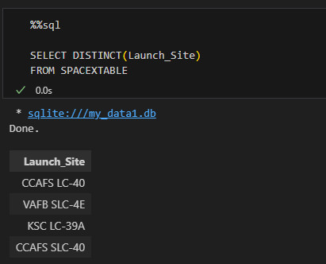
All Launch Site Names

Slide 21
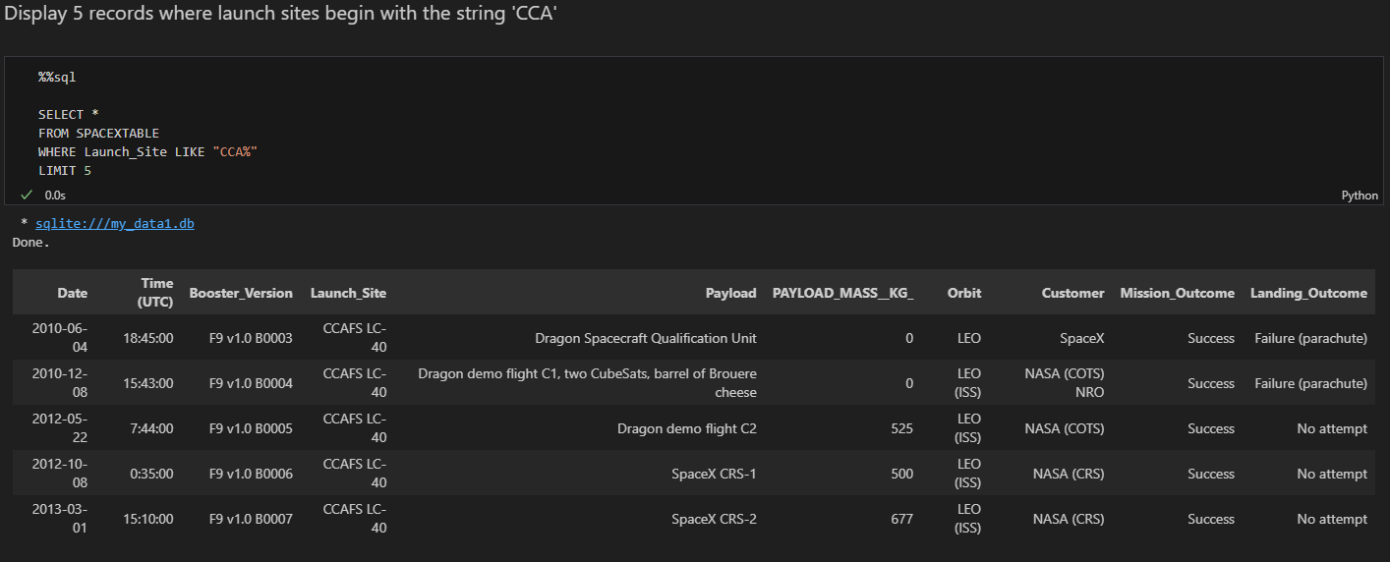
Launch Site Names Begin with 'CCA'

Slide 22
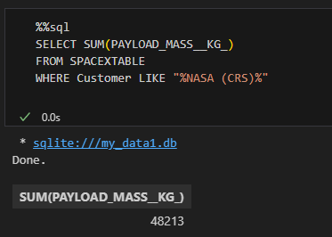
Total Payload Mass

Slide 23
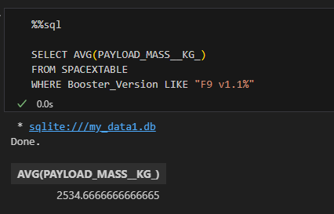
Average Payload Mass by F9 v1.1

Slide 24
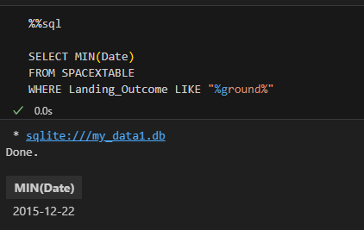
First Successful Ground Landing Date

Slide 25
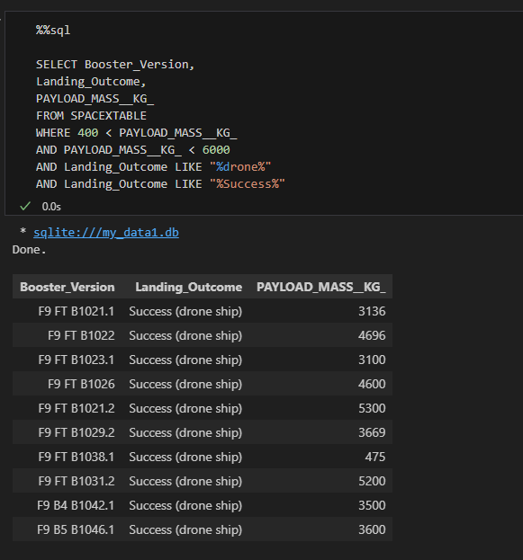
Successful Drone Ship Landing with Payload between 4000 and 6000

Slide 26
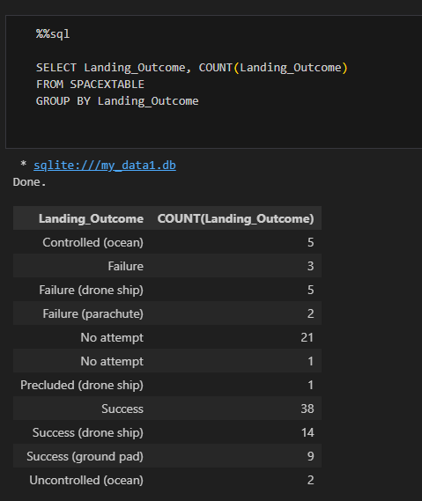
Total Number of Successful and Failure Mission Outcomes

Slide 27
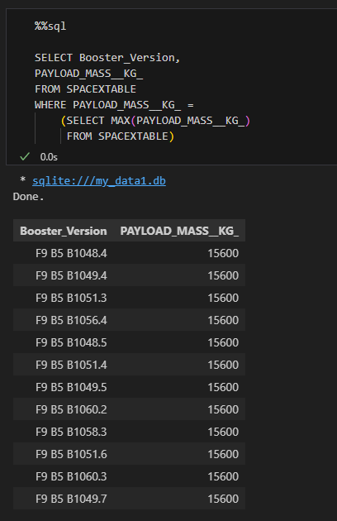
Boosters Carried Maximum Payload

Slide 28
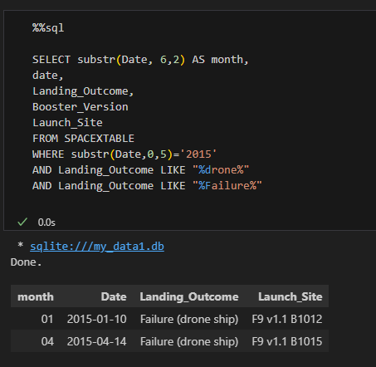
2015 Launch Records

Slide 29
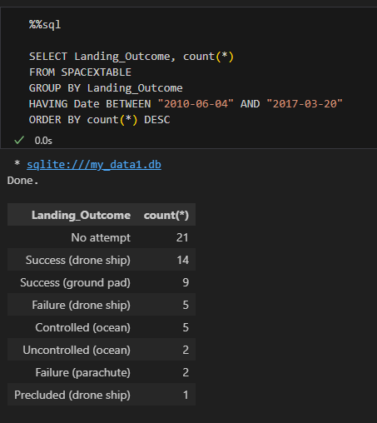
Rank Landing Outcomes Between 2010-06-04 and 2017-03-20

Slide 30

Section 3

Slide 31
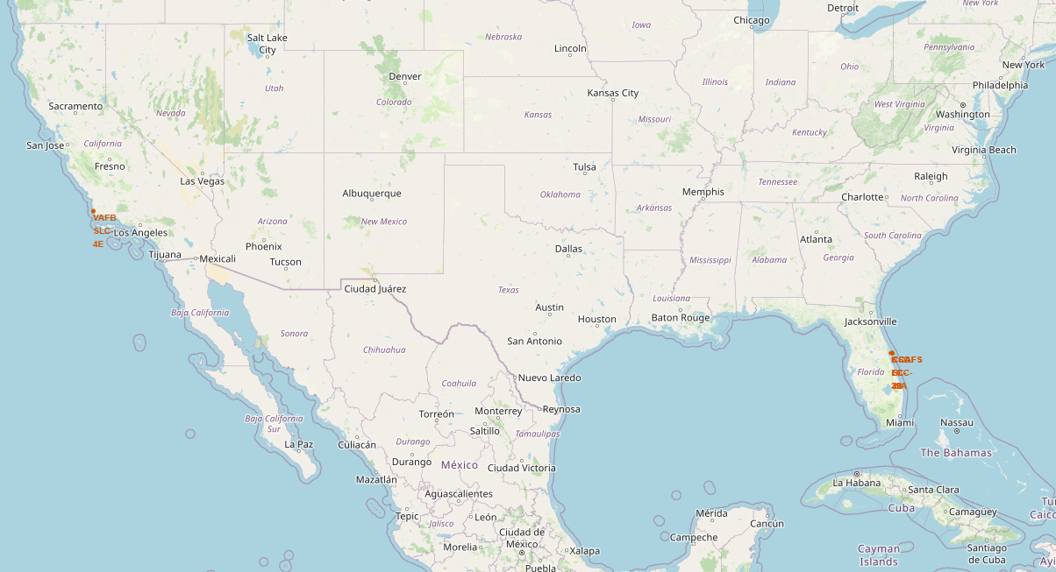
Launch Sites

Slide 32
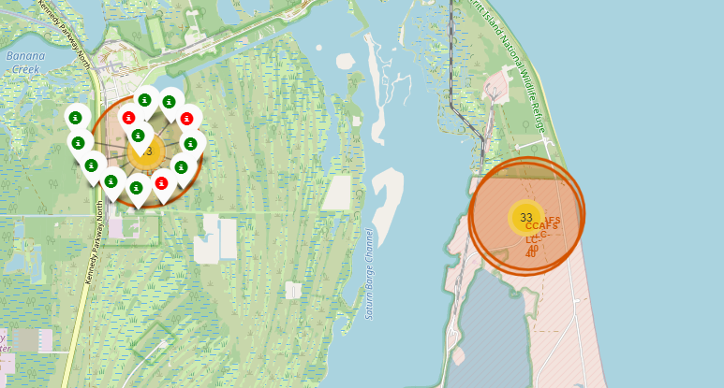
Landing Outcomes

Slide 33
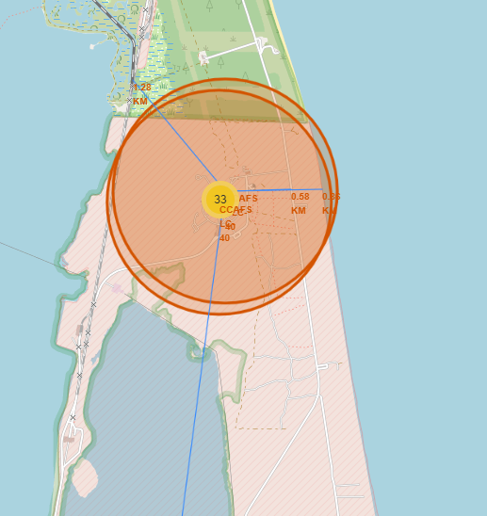
Proximities

Slide 34

Section 4

Slide 35
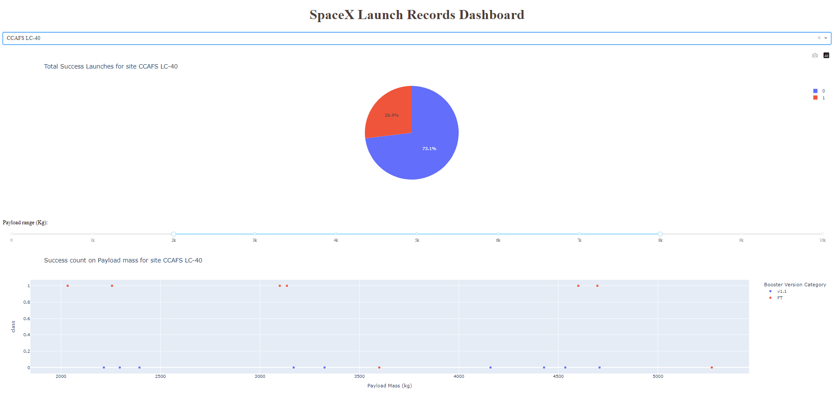
Dashboard

Slide 36

Section 5

Slide 37

Model Selection
In the predictive analysis phase, we begin by conducting exploratory data analysis (EDA) to gain insights into our dataset and determine suitable training labels. This involves creating a column to classify our data into distinct classes, which will serve as our target variable for prediction. Next, we standardize the data to ensure uniformity and mitigate the influence of differing scales. We then split the dataset into training and test subsets to facilitate model training and evaluation. Moving forward, we explore various machine learning algorithms, including Support Vector Machines (SVM), Classification Trees, Logistic Regression, and K-Nearest Neighbors (KNN). For each algorithm, we seek to find the optimal hyperparameters through techniques such as grid search. Subsequently, we evaluate the performance of each method using the test data through cross-validation, confusion matrix analysis, and classification scoring metrics. This comprehensive approach allows us to identify the most effective predictive model for our dataset, enabling us to make informed decisions and derive meaningful insights from the data.

Slide 38

Model Performance
Based on the results of our predictive modeling analysis, it is evident that all the models performed commendably well in terms of accuracy. The Logistic Regression and Support Vector Machine (SVM) models both achieved high accuracy scores of approximately 84.6% and 84.8%, respectively. Additionally, the Classification Tree model demonstrated even higher accuracy, reaching approximately 87.3%. Similarly, the K-Nearest Neighbors (KNN) model yielded a competitive accuracy score of approximately 84.8%. These findings indicate that each model was effective in capturing the underlying patterns within the data and making accurate predictions. However, while all models performed relatively well, the Classification Tree model stood out with the highest accuracy, suggesting its potential superiority in this particular predictive task. Overall, the results underscore the efficacy of machine learning techniques in predictive analysis and highlight the importance of selecting appropriate algorithms tailored to the specific characteristics of the dataset.

Slide 39
Conclusions
The successful completion of this project highlights the critical role of preprocessing techniques in predictive analytics for rocket launches.
Meticulous data collection efforts, including API data gathering and web scraping, provided a comprehensive dataset essential for model training.
Preprocessing steps such as data wrangling, exploratory data analysis (EDA), and data visualization ensured the quality and integrity of the dataset.
Insights derived from EDA, facilitated by SQL queries and visualization tools like Folium, guided model selection and hyperparameter tuning.
Model evaluation revealed the Classification Tree as the top performer, achieving an accuracy of approximately 87.3%.
These findings underscore the importance of robust preprocessing pipelines in extracting actionable insights and facilitating informed decision-making in the commercial space industry.

Slide 40


